Slide 1

Complementary electronics components
Content :
Voltage source
Switches
Basic electronics component (R, L, C)
Basic semiconductor component (diode, led, BJT transistor, MOSFET transistor)
ESP32 microcontroller circuit
Light measurement (LDR SENSOR circuit)
Water level measurement (resistive water level sensor circuit)
Heat measurement (DHT11, RTD circuit)
Controlling DC load (MOSFET Driver circuit)
Controlling AC load (relay, solid state relay circuit)
TRIVIA QUIZ : Identifying components for SMKDT IOT expo
Speaker : Muhammad Husni, S. Pd
Python Programmer
Alumni SMKDT Angkatan 4 (Geist In Vier)

Slide 2
About me
Name : Muhammad Husni Muttaqin, S. Pd.
Birth date : 5 June 1998
Hometown : Bandung
Current Job : Python programmer at PT Syergie Indoprima
Experiences : - 2019 : Dynamics Positioning System control system engineer on cable ship kalibaru – untung jawa 20Kv cable installation (PT Syergie Indoprima)
- 2019 : Dynamics Positioning System control system engineer on cable ship lampung – pahawang 20Kv cable installation (PT Syergie Indoprima)
- 2020 : Dynamics Positioning System control system engineer on cable ship palapa ring tengah cable maintenance (PT Syergie Indoprima)
- 2021 - 2022 : Electronics and control system engineer for Vent-I (PT Syergie Automa Teknologi)
- 2022 : python programmer

Slide 3
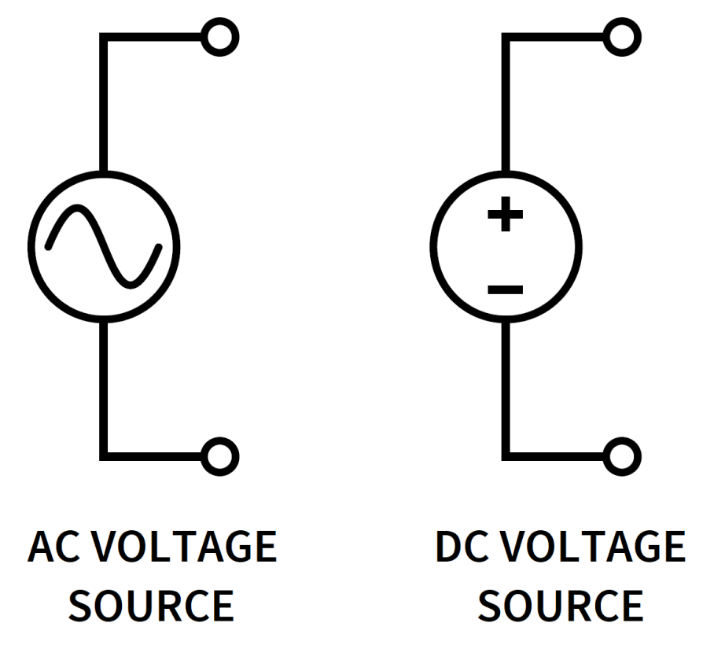
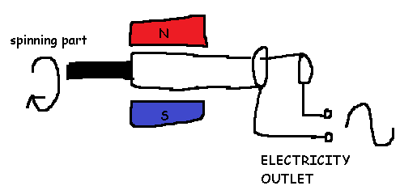
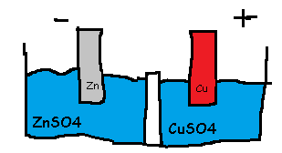
Voltage source

Slide 4
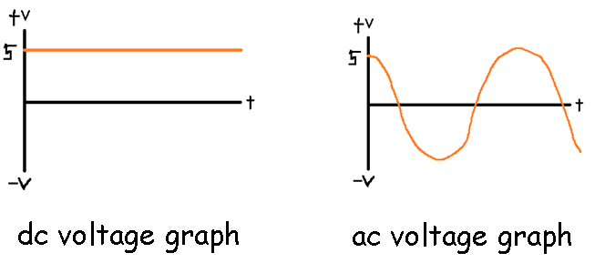
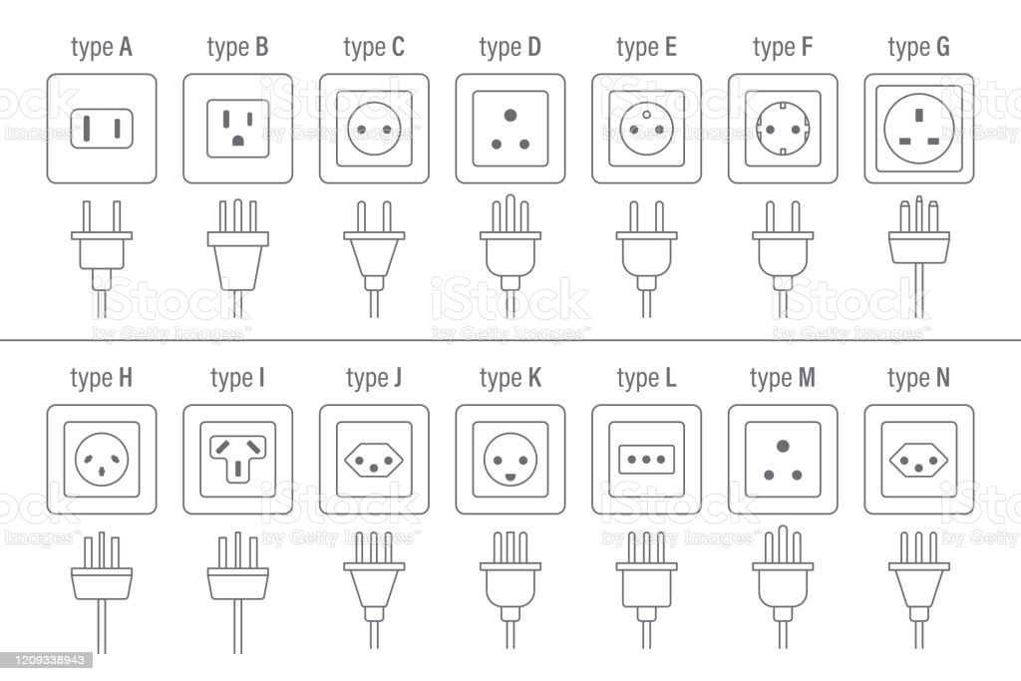
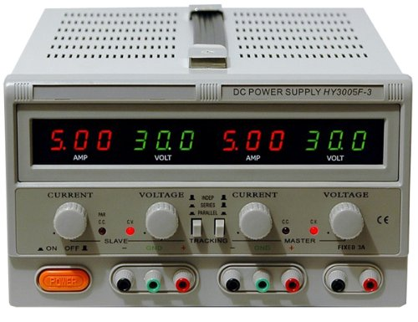
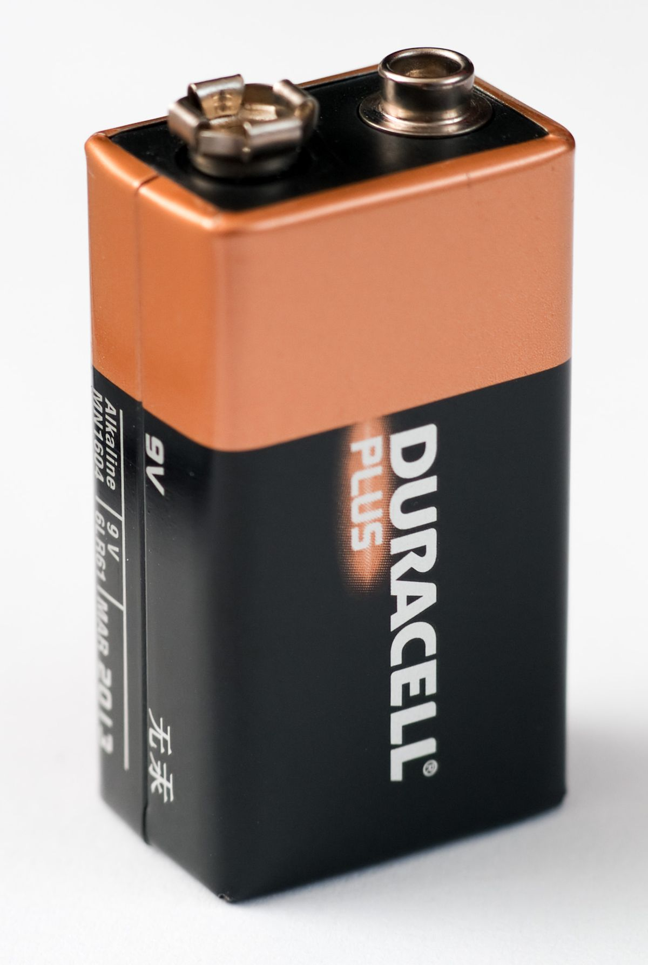
Voltage source

Slide 5
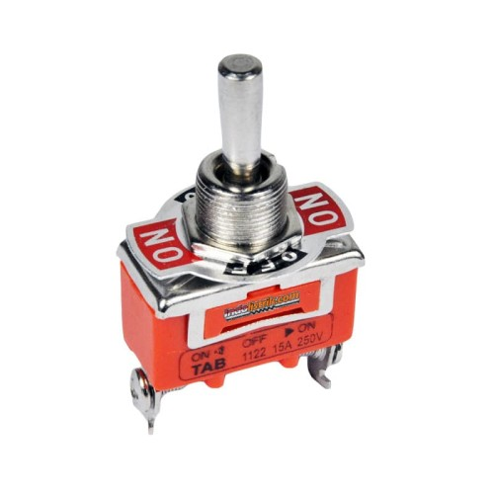
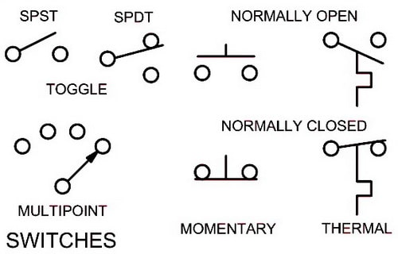
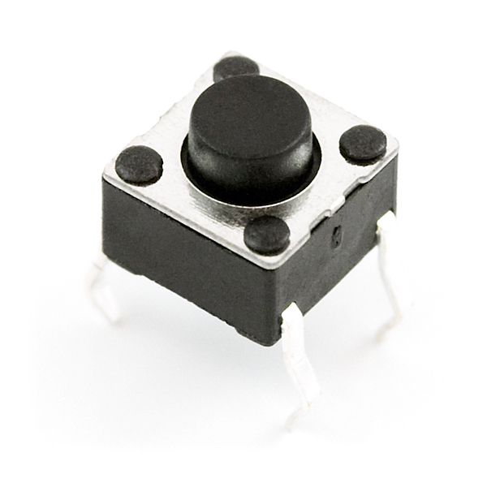
Switches

Slide 6
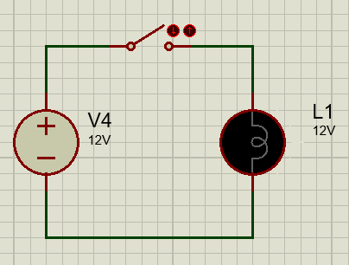
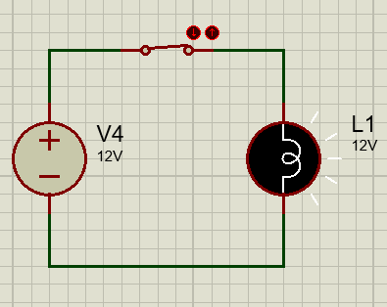

Slide 7
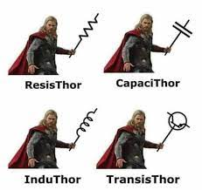
Basic electronics component (R, L, C)

Slide 8
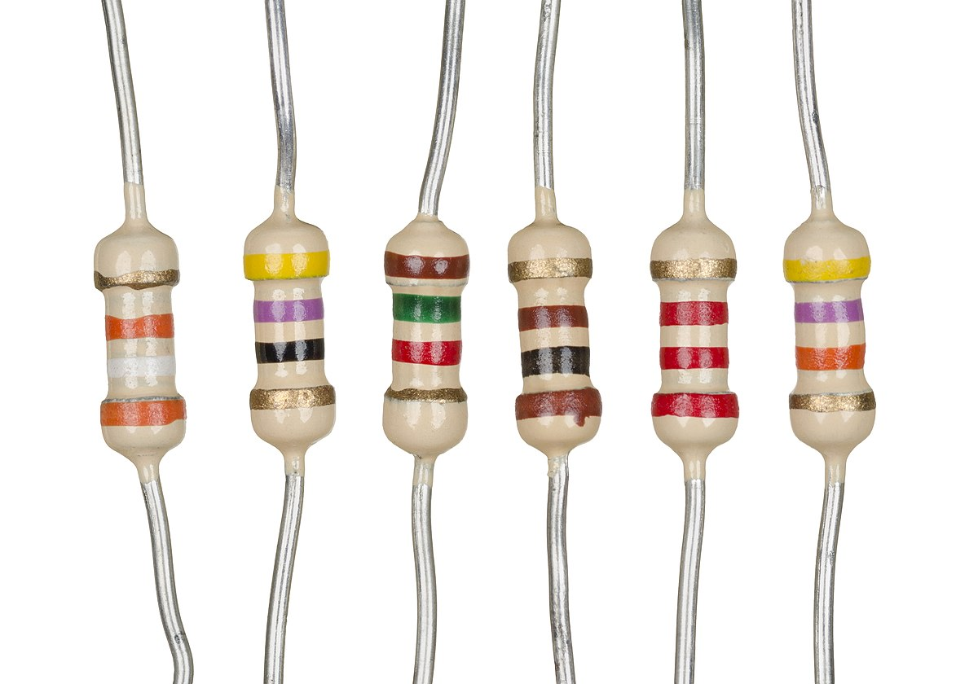
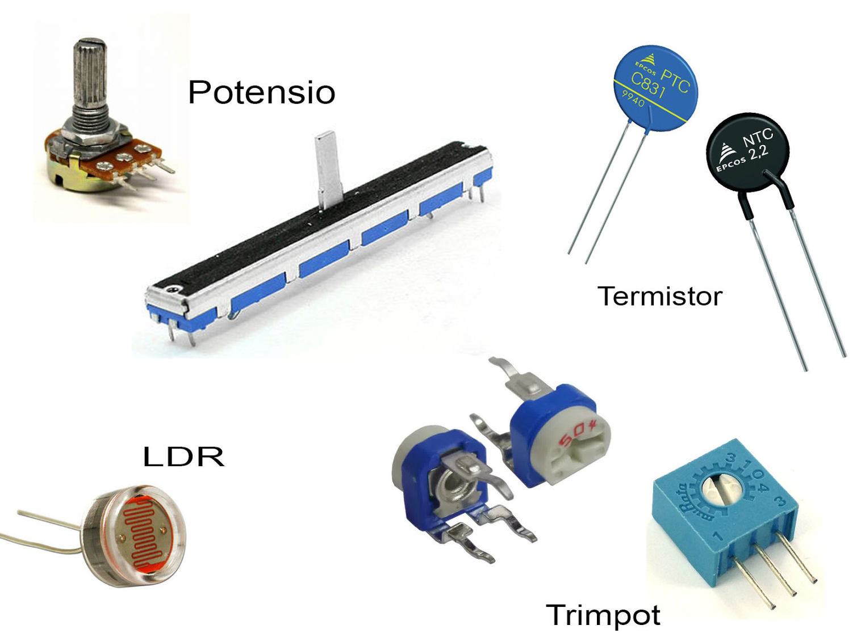

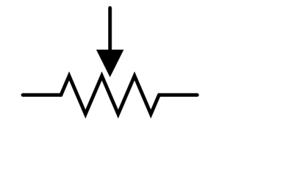
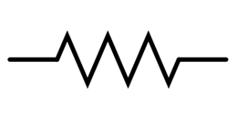
resistor

Slide 9
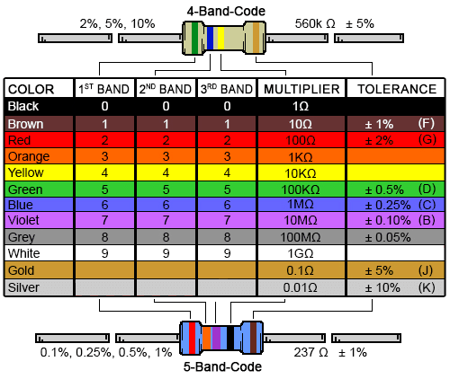
Fixed resistor

Slide 10
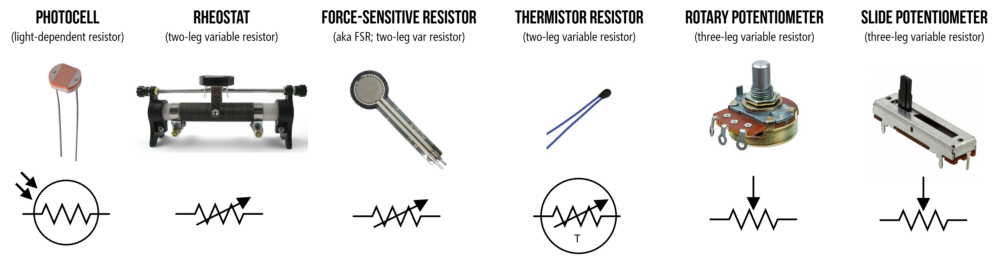
Variable resistor

Slide 11
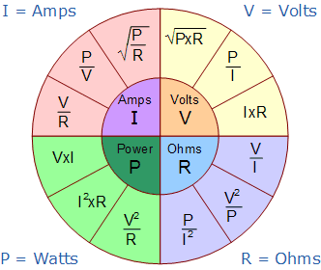
Resistor basic equation
V = i*r

Slide 12
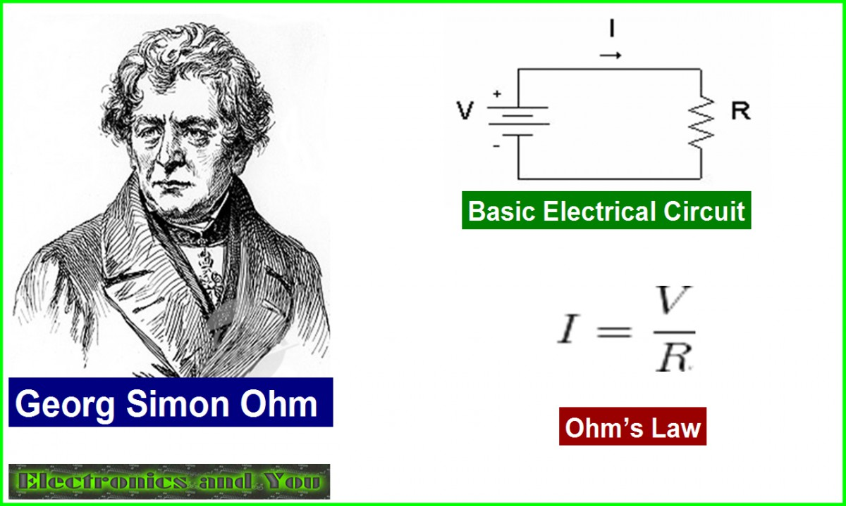

Slide 13
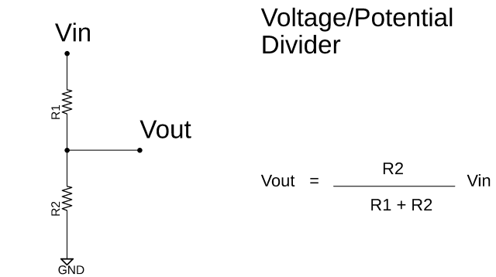

Slide 14
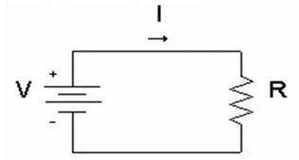
Let’s go to example

Slide 15
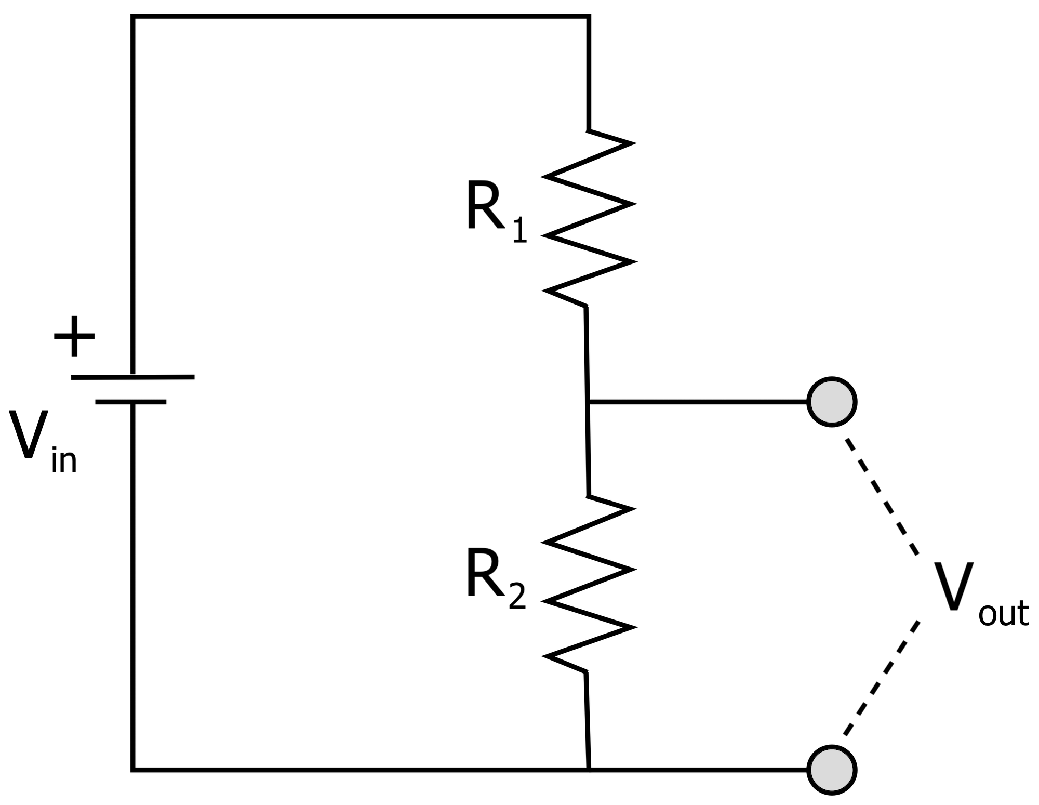
Let’s go to example

Slide 16
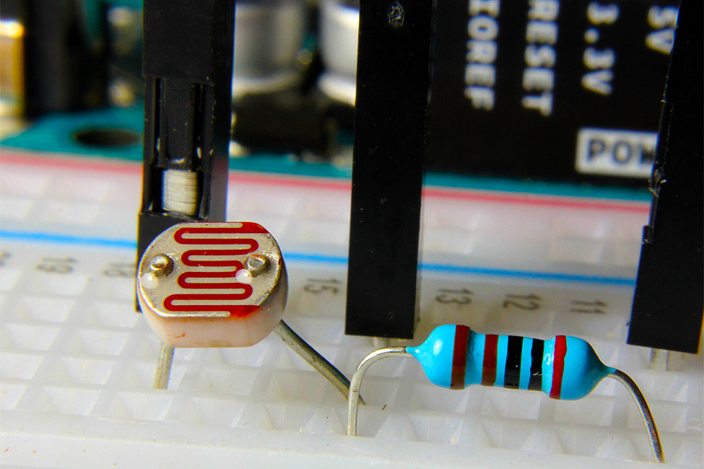
Practical case

Slide 17
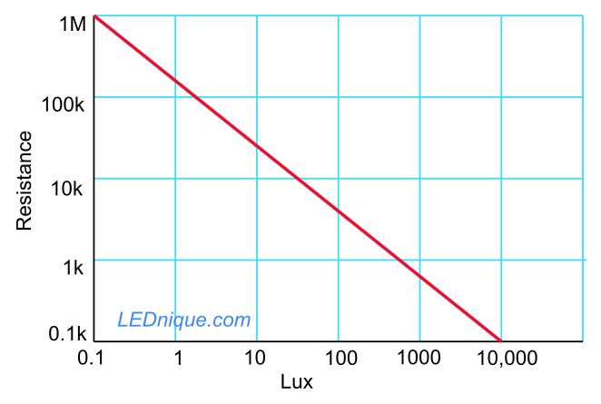
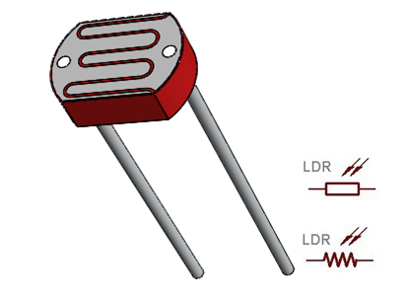

Slide 18
Let’s go to example
- Vin : 5v
- R2 :
Dark : 100k ohm (example)
Bright : 100 ohm (example)
R1 : 100k
Calculate Vout :

Slide 19
Let’s go to example
-Vin : 5v
- R1 :
Dark : 100k ohm (example)
Bright : 100 ohm (example)
R2 : 100k
Calculate Vout

Slide 20
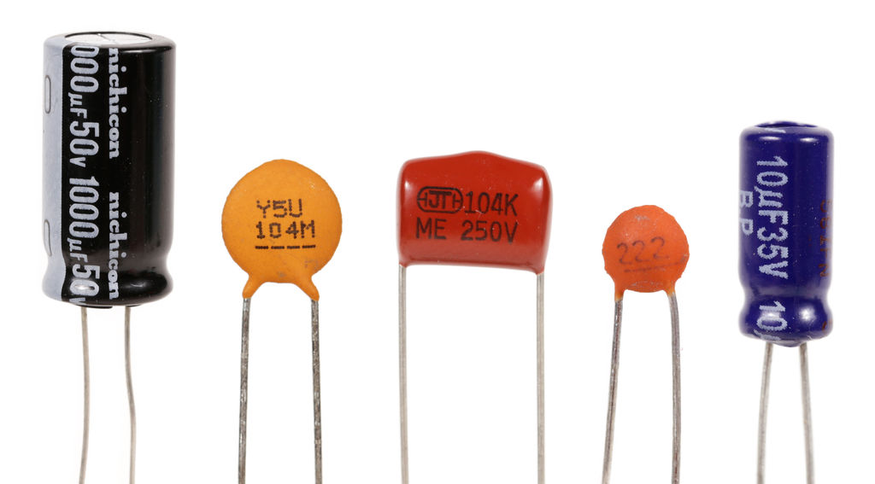
capacitor

Slide 21
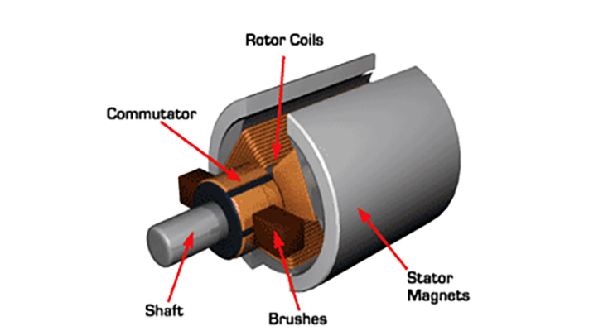
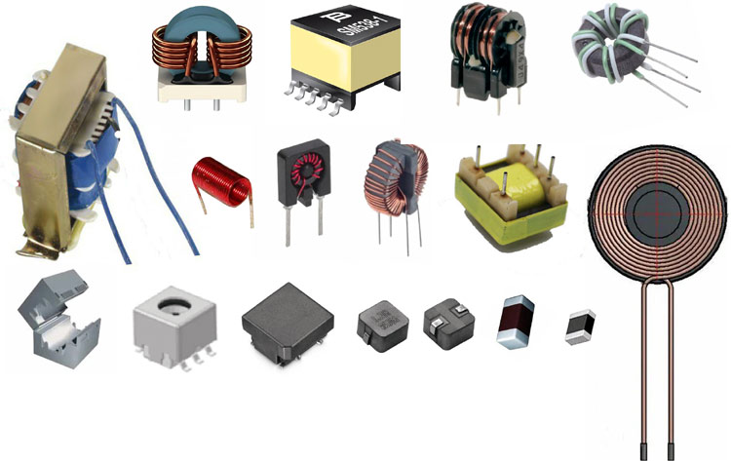
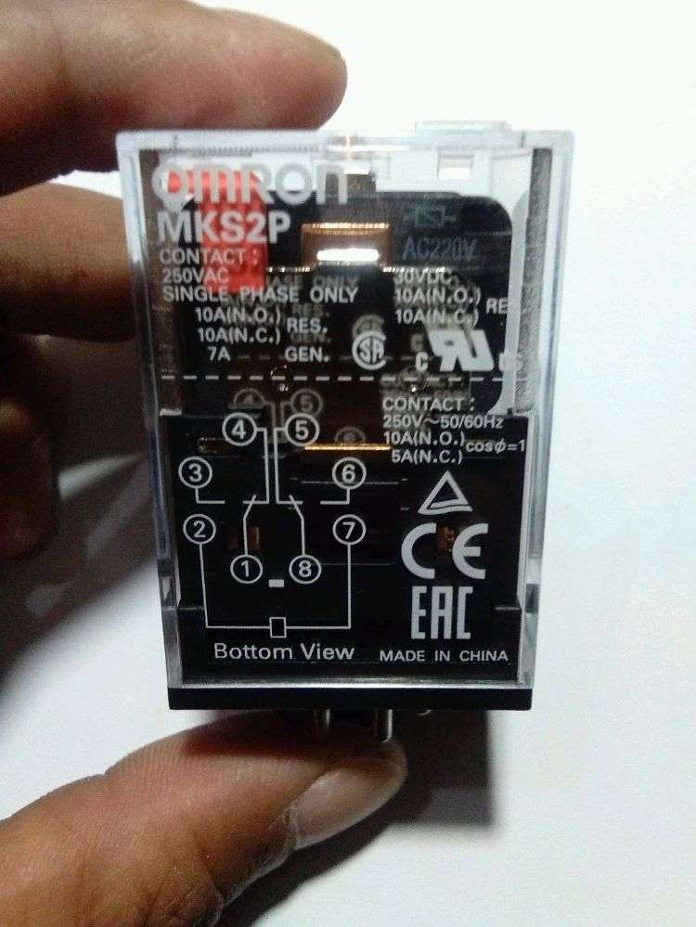
inductor

Slide 22
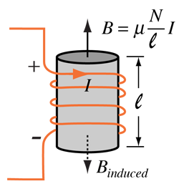

Slide 23
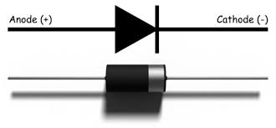
diode
1n4001 – 1n4007
1n5819

Slide 24
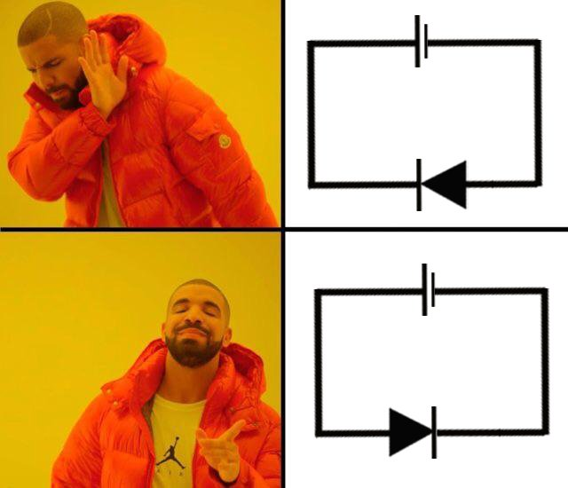
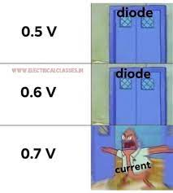

Slide 25
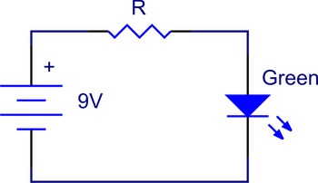
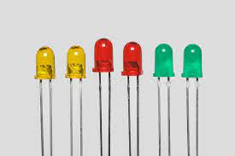
led

Slide 26
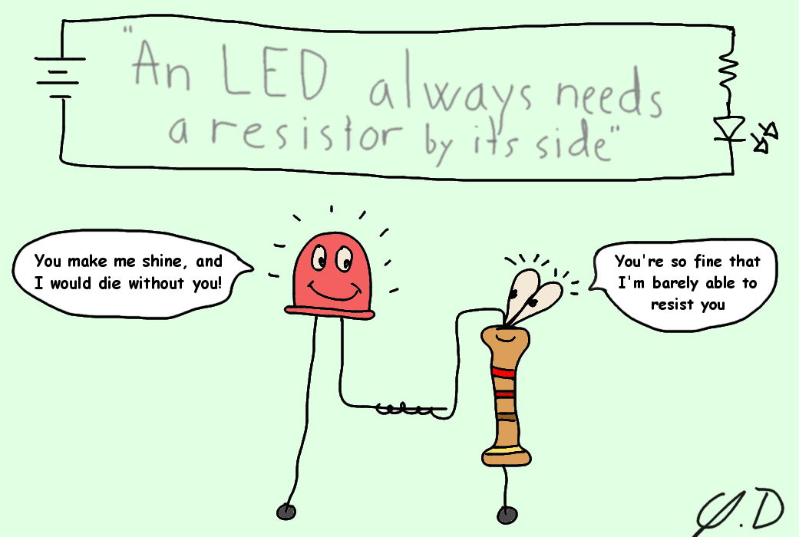
led
Practical tips : use 330 – 1k ohm resistor for led

Slide 27
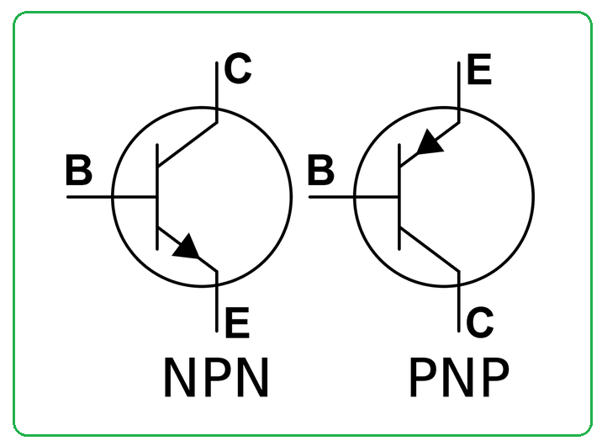
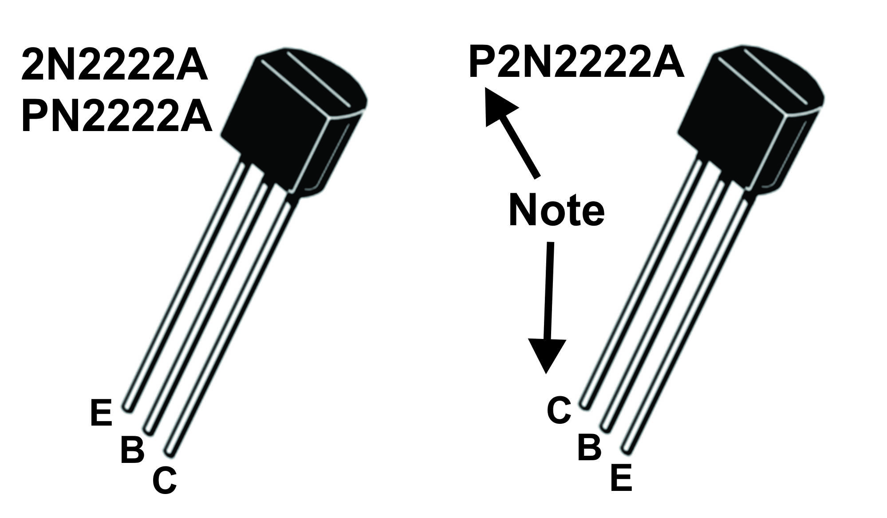
Basic semiconductor component (diode,led , BJT transistor, MOSFET transistor)
BJT Transistor type

Slide 28
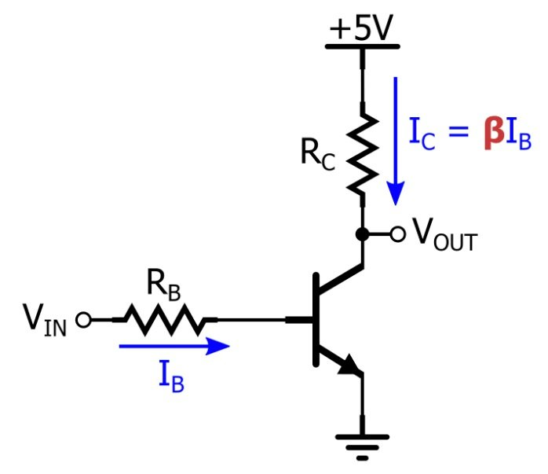

Slide 29
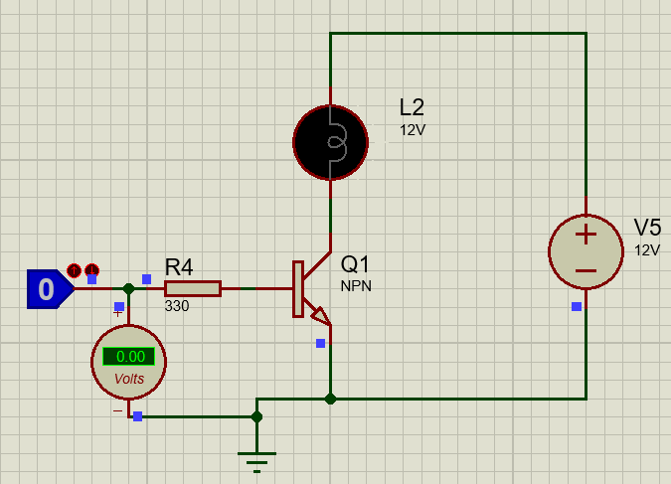
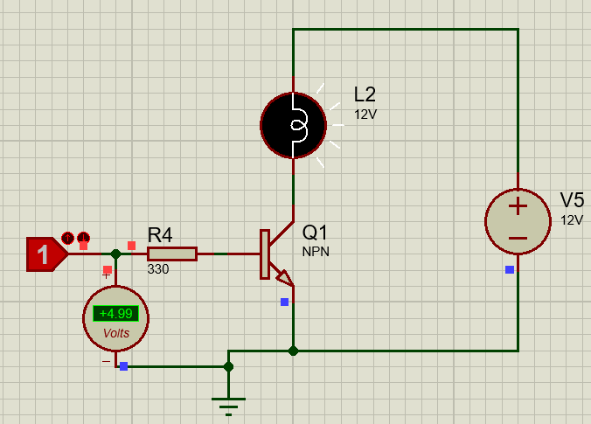
Basic semiconductor component (diode,led , BJT transistor, MOSFET transistor, TRIAC)
BJT Transistor type NPN series 2n2222 or BC138

Slide 30
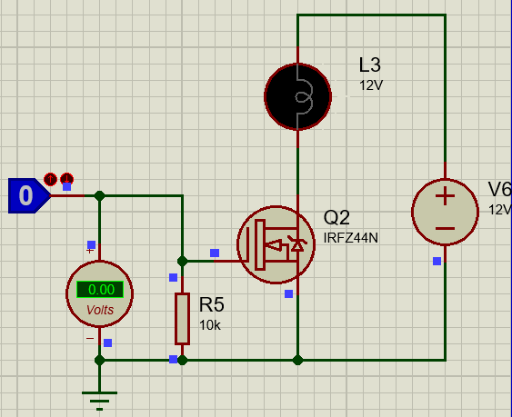
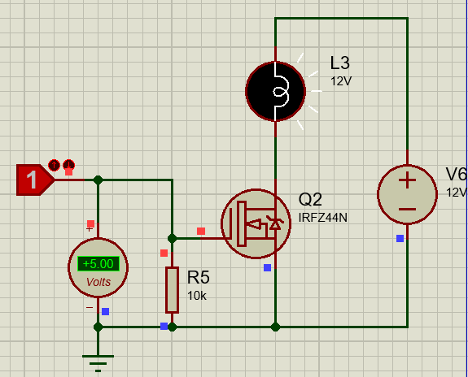
Basic semiconductor component (diode,led , BJT transistor, MOSFET transistor, TRIAC)
N CHANNEL MOSFET type IRFZ44N

Slide 31
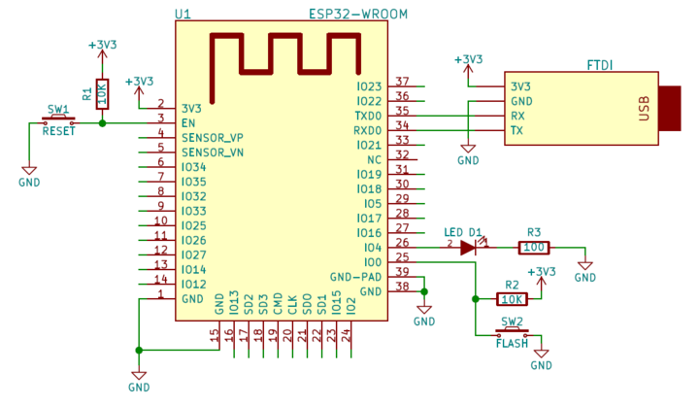
ESP32 microcontroller circuit

Slide 32
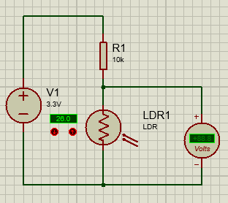
Light measurement (LDR SENSOR circuit)

Slide 33
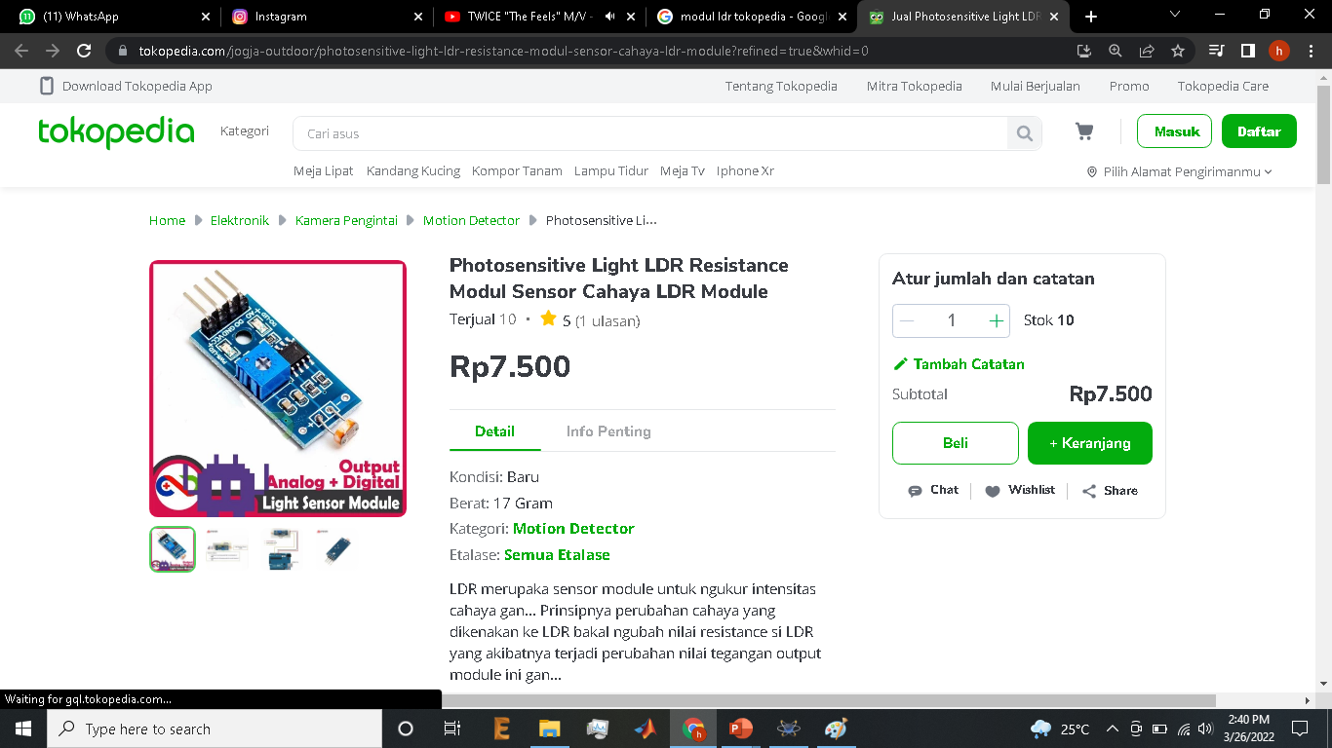
Light measurement (LDR SENSOR circuit)

Slide 34
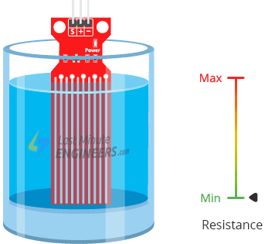
Water level measurement (resistive water level sensor circuit)
REMEMBER VOLTAGE DIVIDER PLEASE ☺

Slide 35
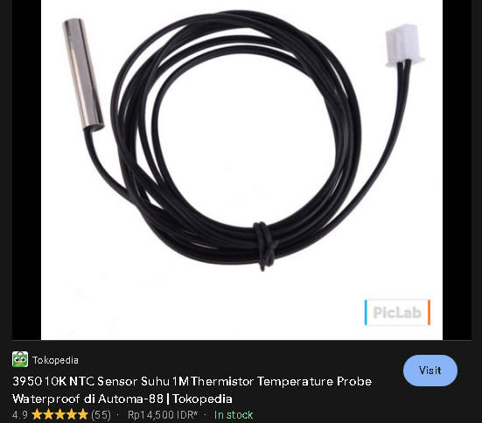

Heat measurement (DHT11, RTD circuit)

Slide 36

Controlling DC load (MOSFET Driver circuit)

Slide 37


Controlling AC load (relay circuit)

Slide 38


Slide 39


Controlling AC load (solid state relay circuit)

Slide 40
TRIVIA QUIZ : Identifying components for expo
Stand 1
Stand 2
Stand 3
Stand 4
Stand 5
Stand 6
Stand 7
Stand 8

Slide 41

Design References

Slide 42


Slide 43


Slide 44


